Slide 1
Create Info-area and Enter the data manually
Milind Parab

Slide 2
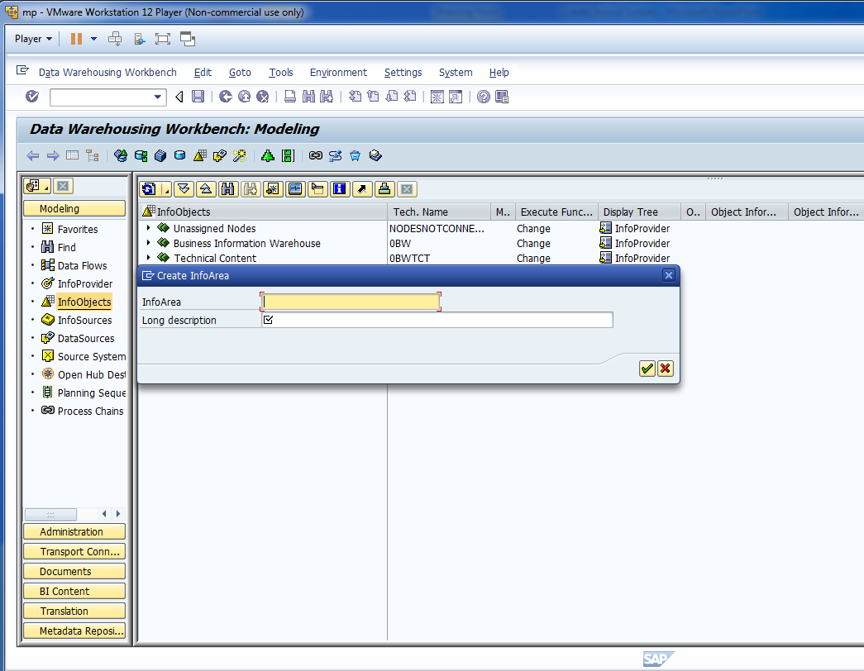
Create Info-Area : IA_Demo1

Slide 3
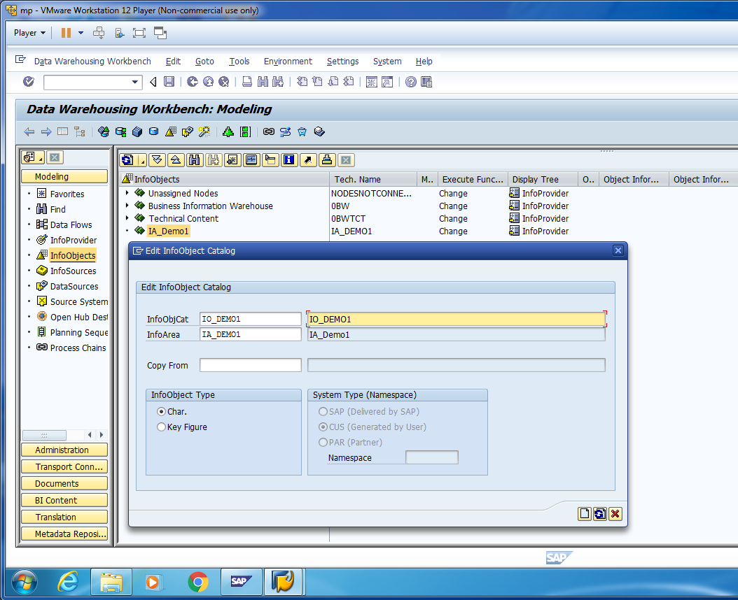
Right Click on Info-Area and create an Info-Object Catalog.

Slide 4
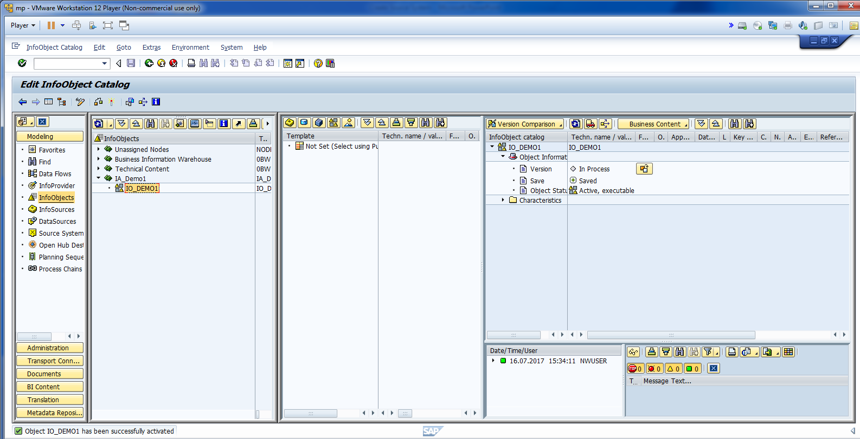
Activate Info-Object Catalog.

Slide 5
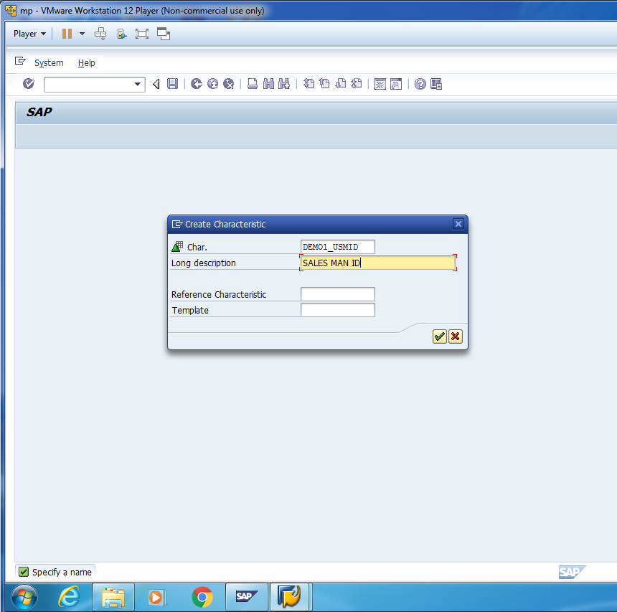
Right Click on Info-Object Catalog and Create Info-Object.

Slide 6
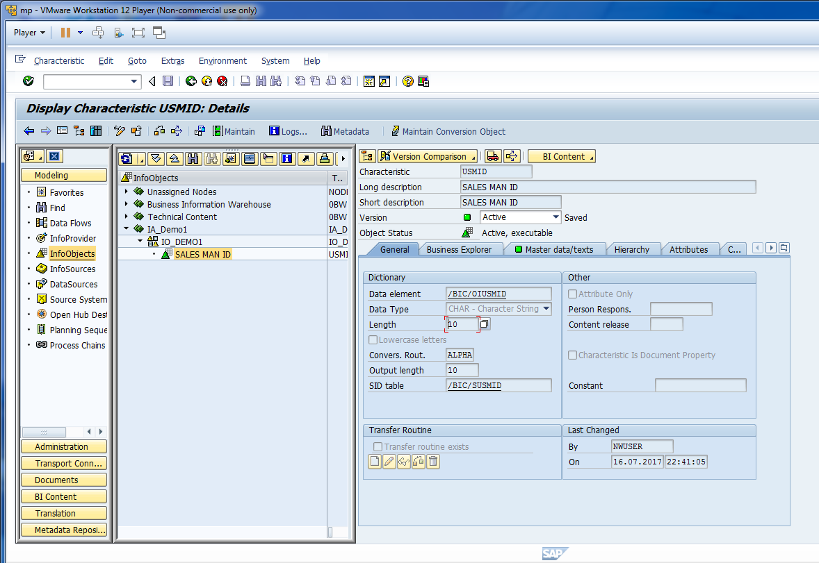
Once you create the Object, activate the object.

Slide 7
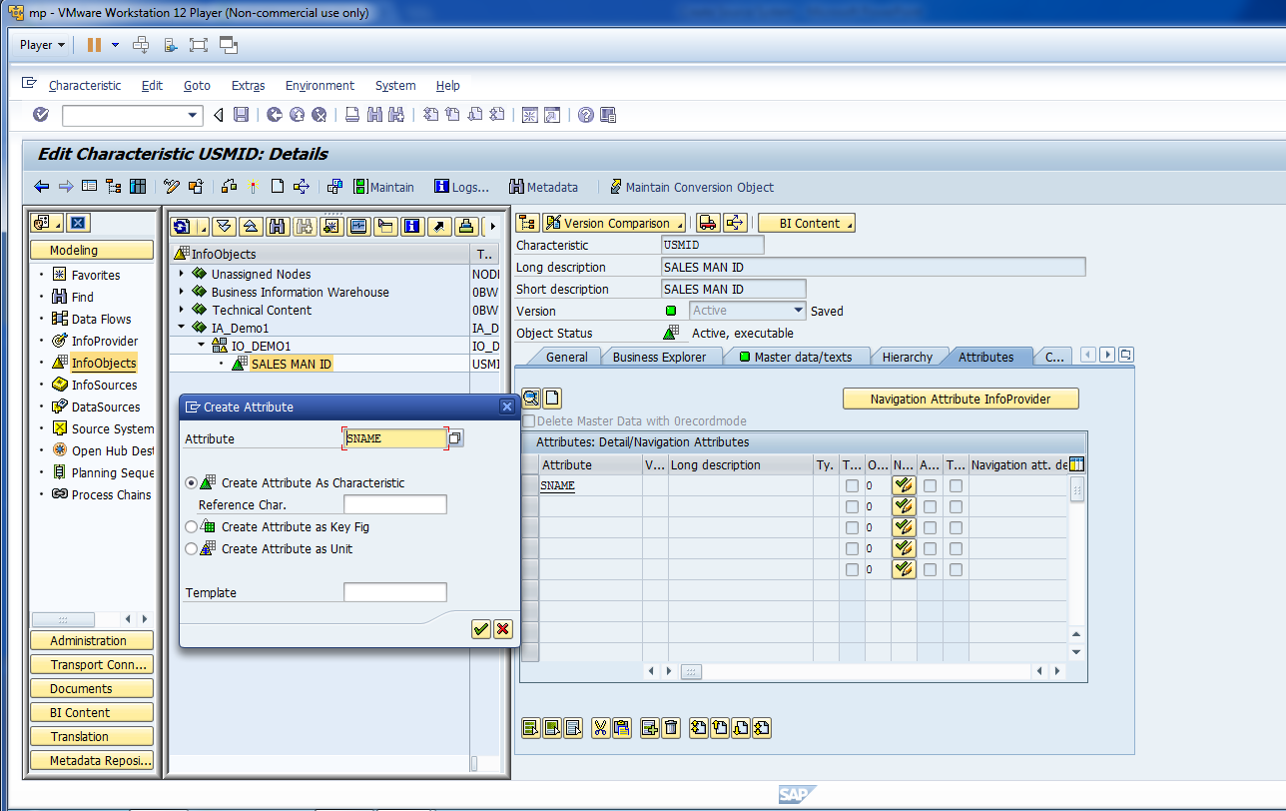
Create Char. Attributes.

Slide 8
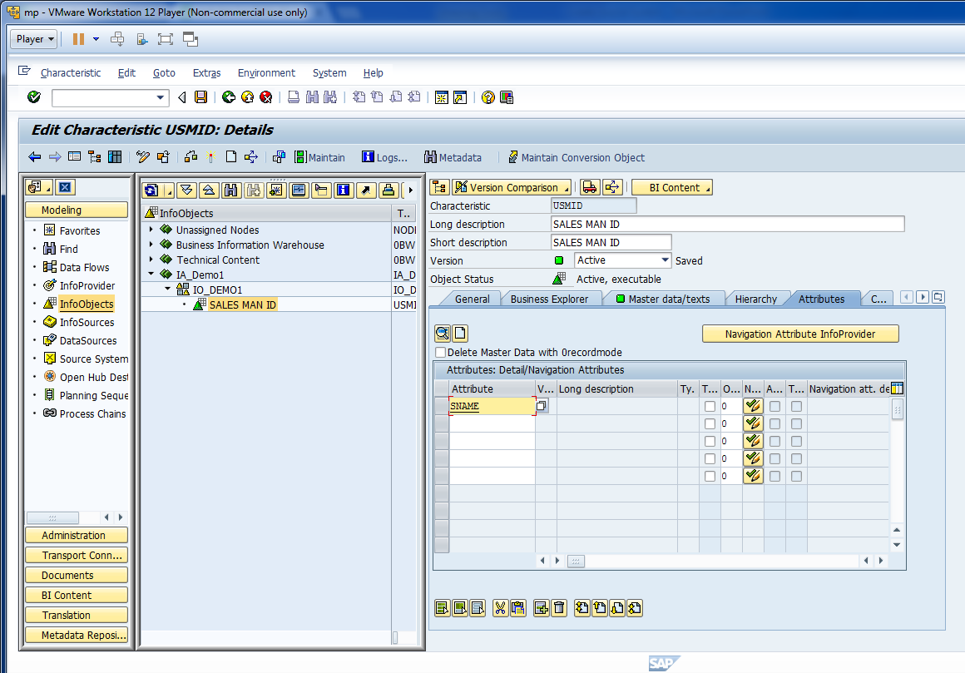
Now, create attributes for Sales Man.

Slide 9
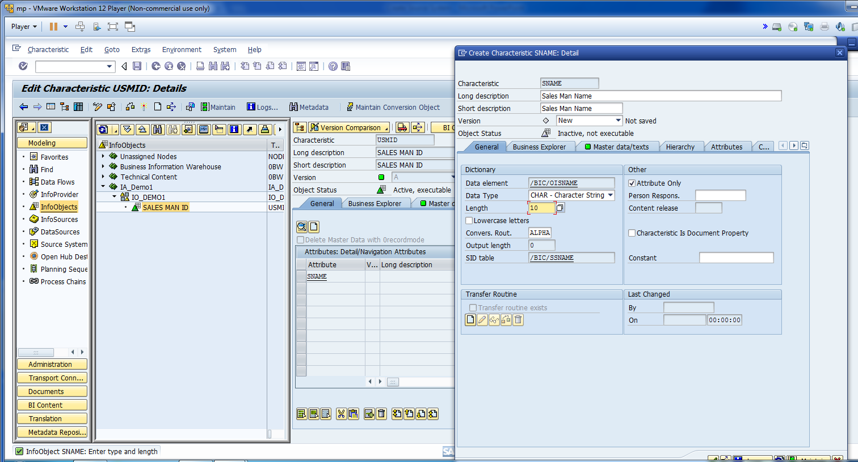
Fill out the information for Attributes.

Slide 10
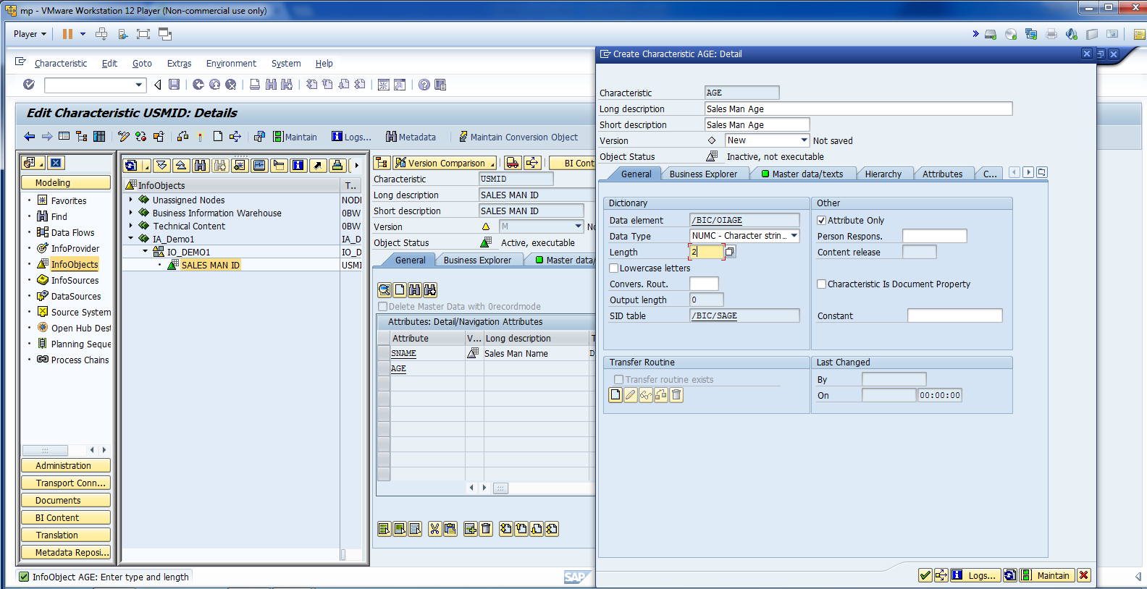
Create Attribute Age.

Slide 11
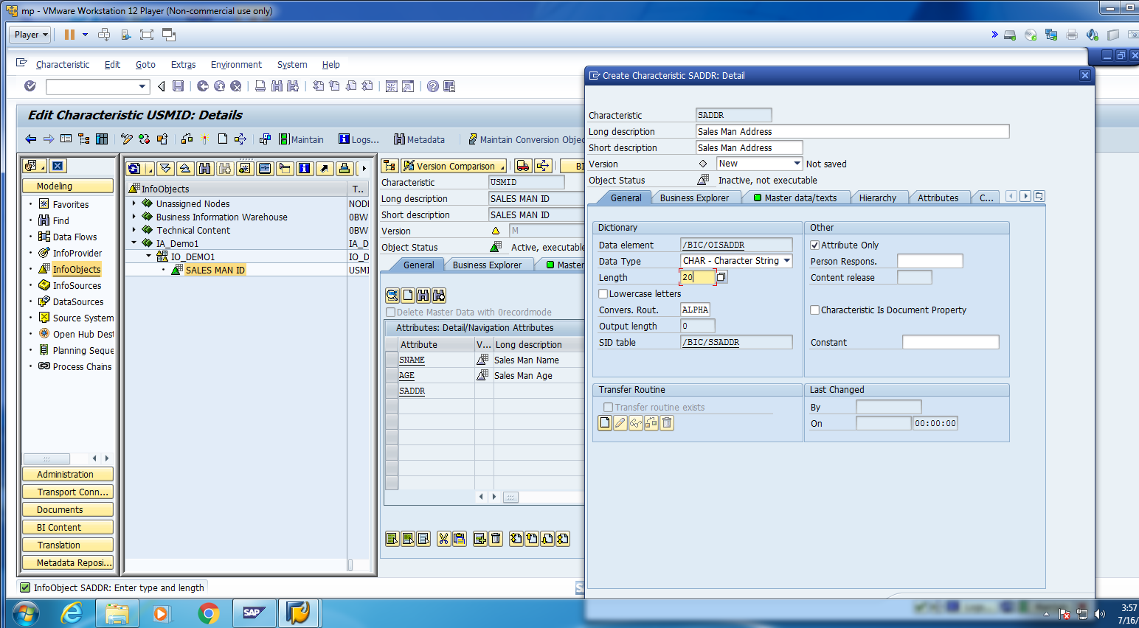
Create Attribute Address.

Slide 12
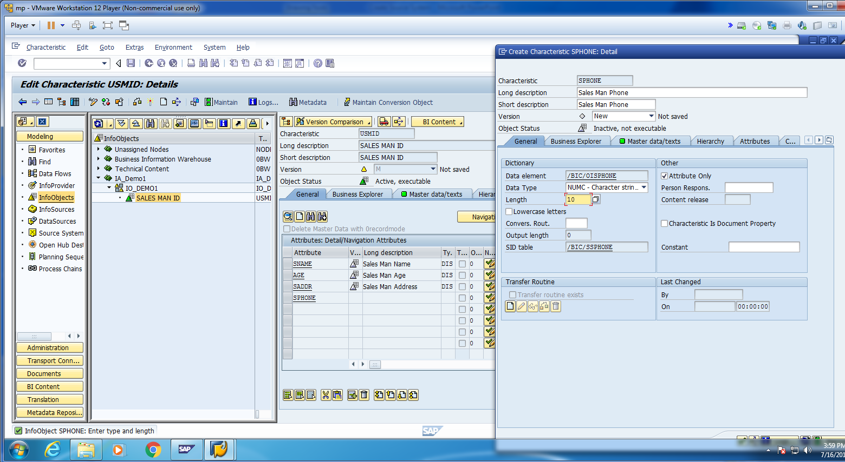
Create Attribute Phone.

Slide 13
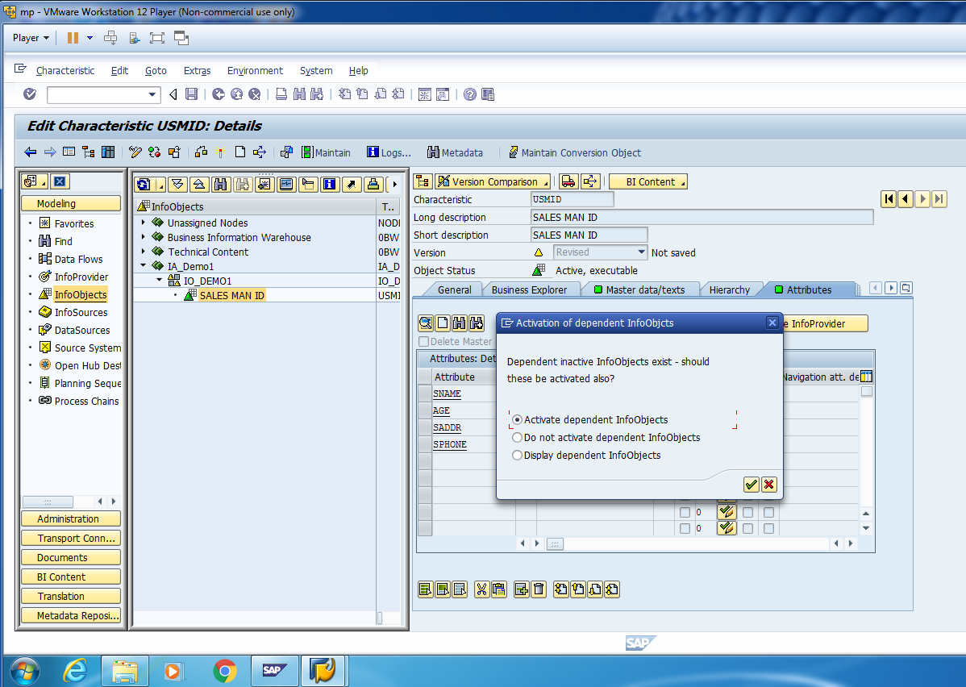
Activate as dependent Info-Object.

Slide 14
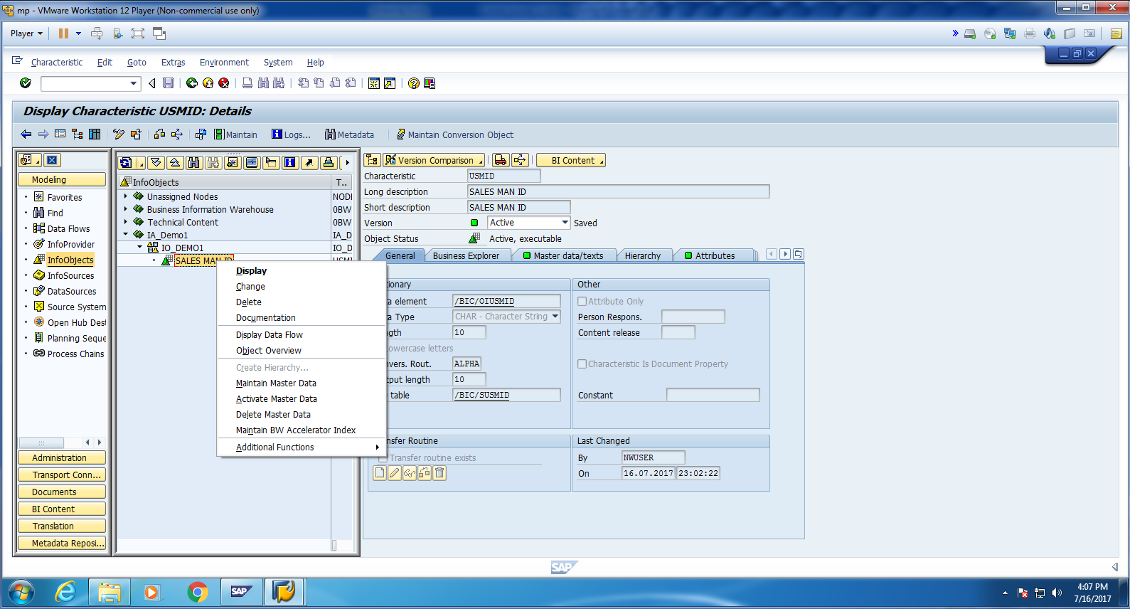
Go to Maintain Master Data.

Slide 15
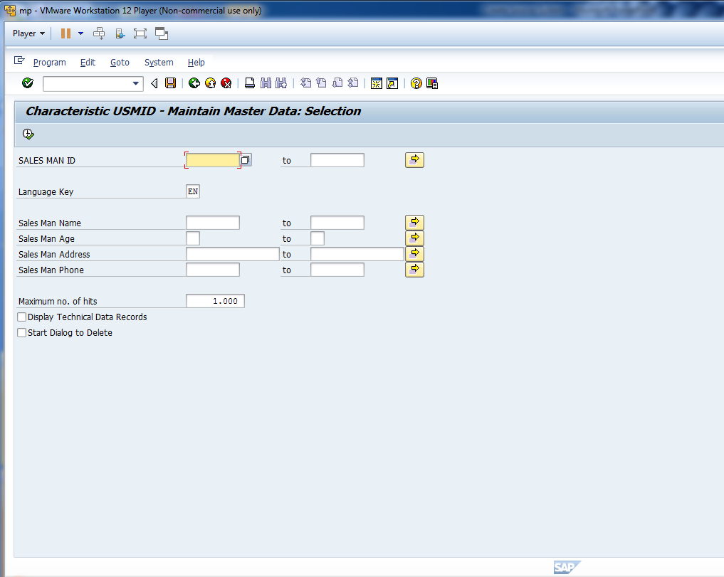
Cont.

Slide 16
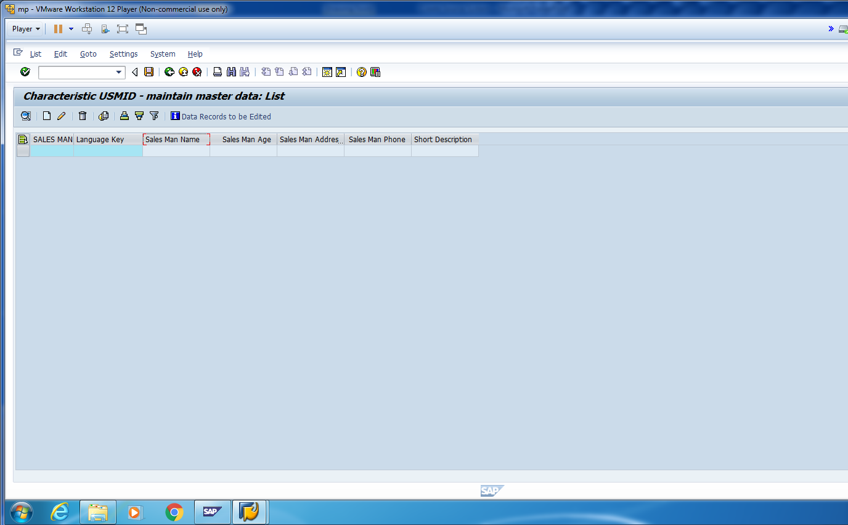
It is empty.

Slide 17
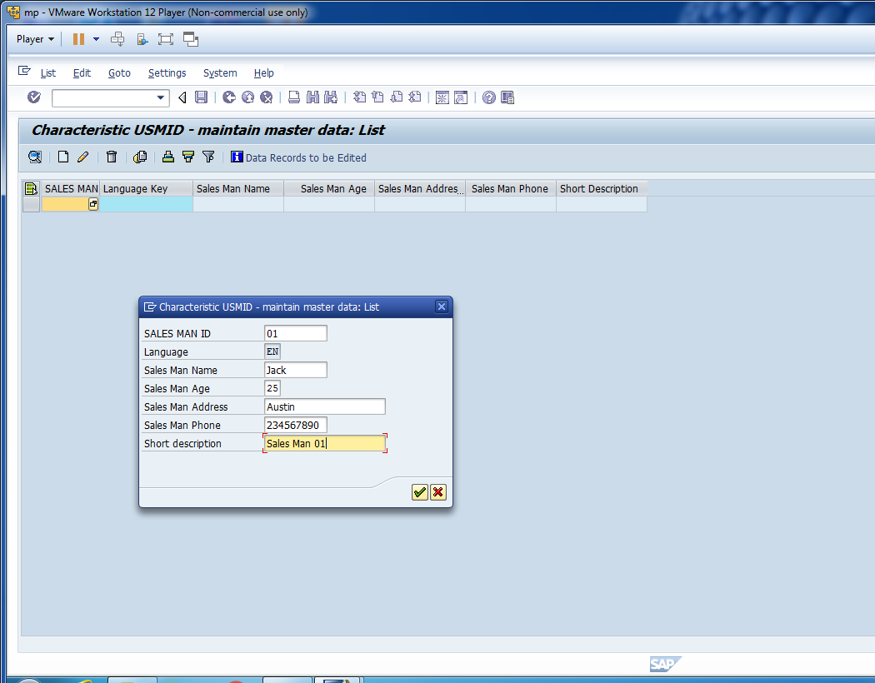
Click on Create and Enter the details.

Slide 18
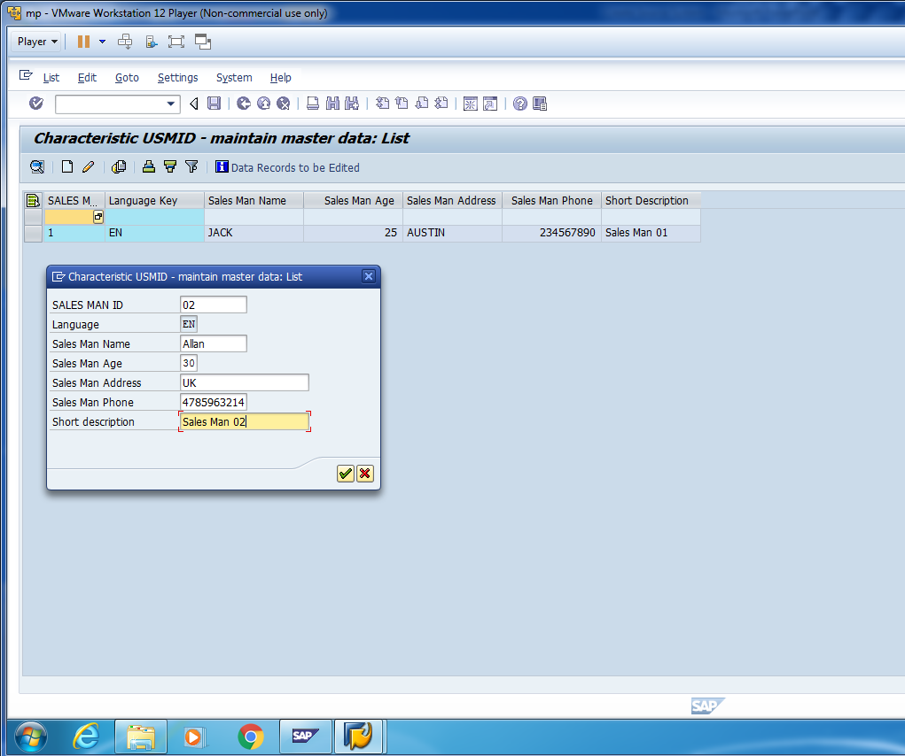
Create another record.

Slide 19
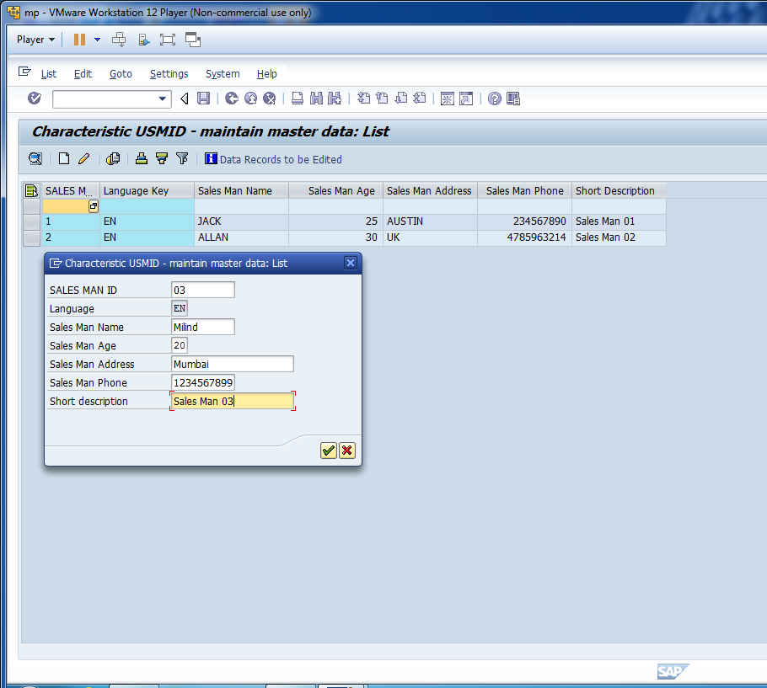
Create one more record and save data.

Slide 20
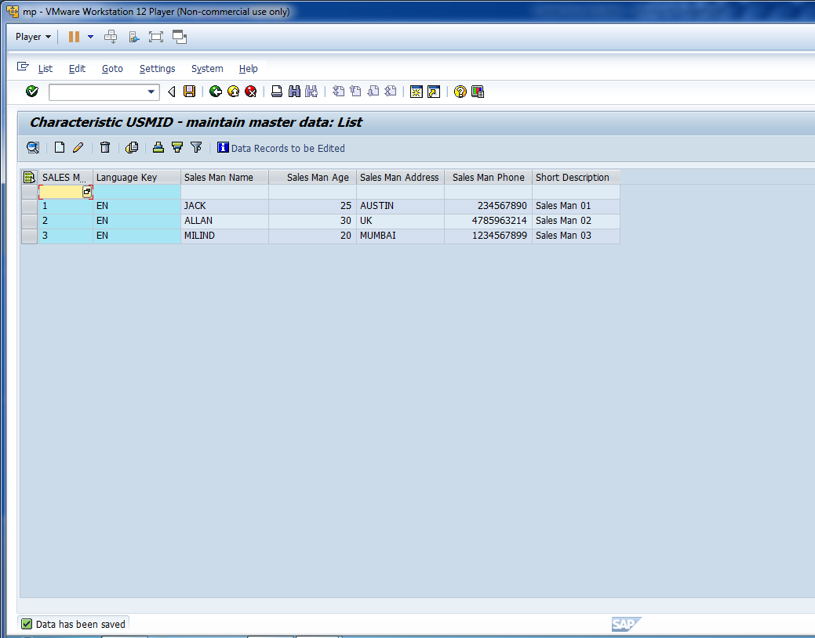
Save the data and go to T-code“SE11”.

Slide 21
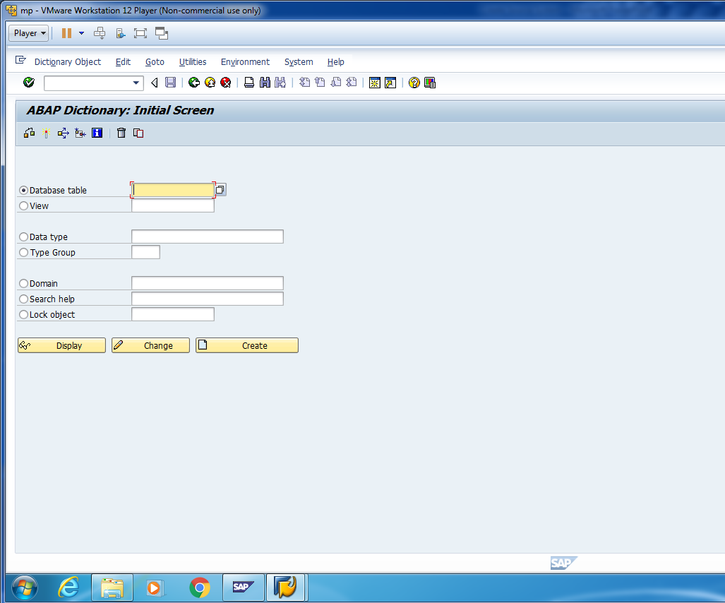
Cont.

Slide 22
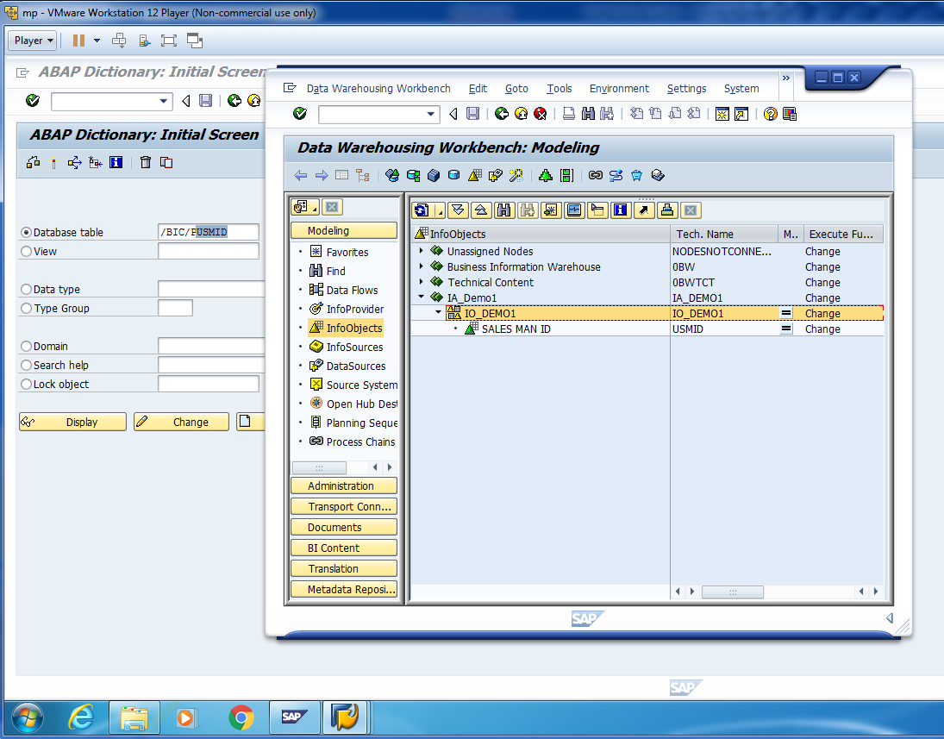
Check the data in P- Table.

Slide 23
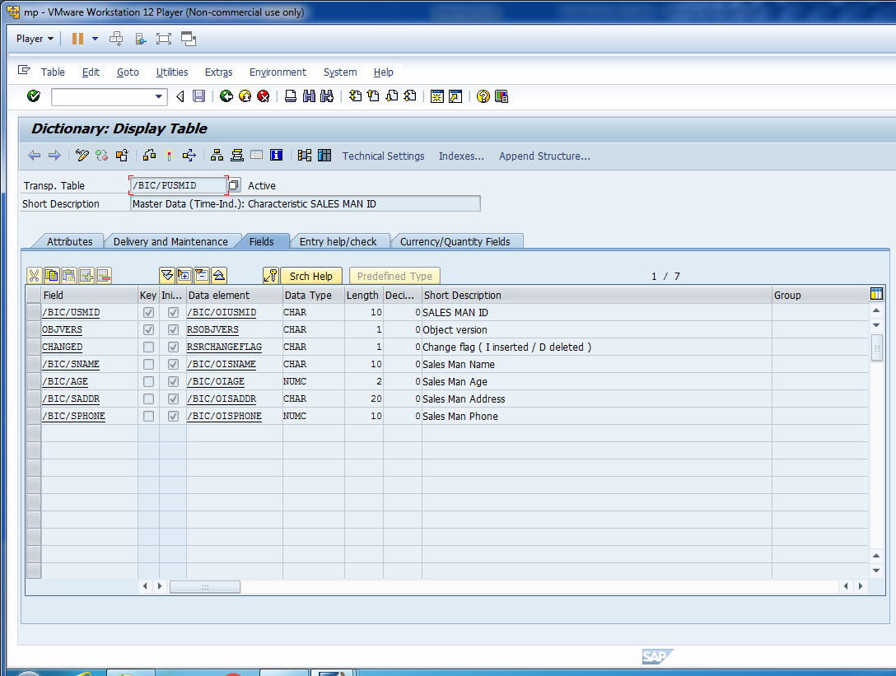
Cont.

Slide 24
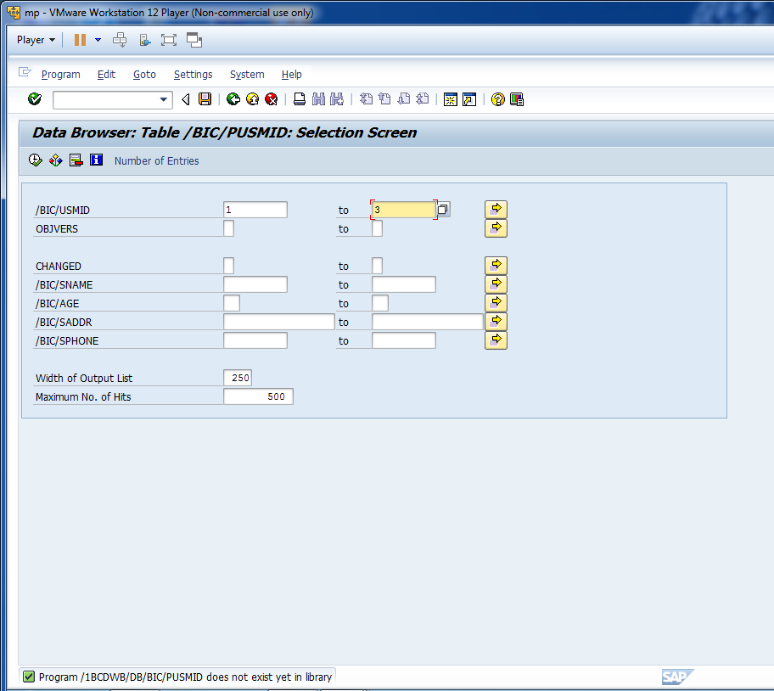
Let’s say we want to see first 3 records.

Slide 25
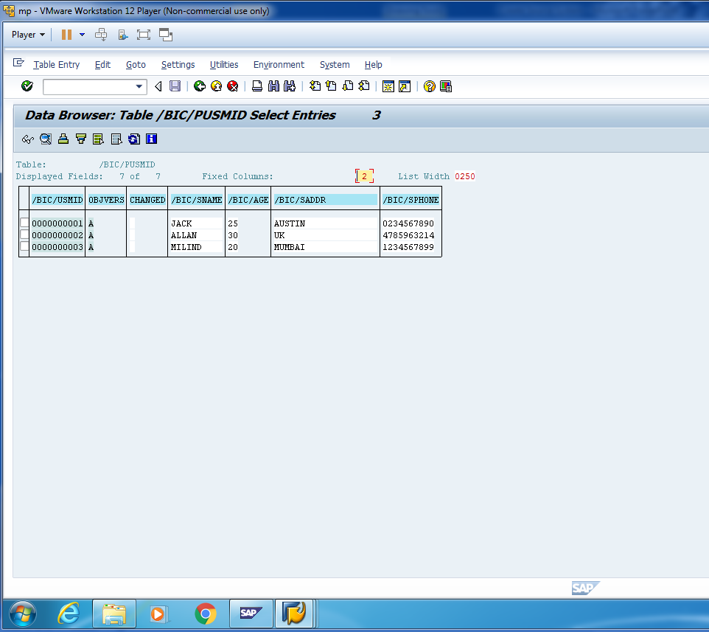
Content in P-Table.

Slide 26
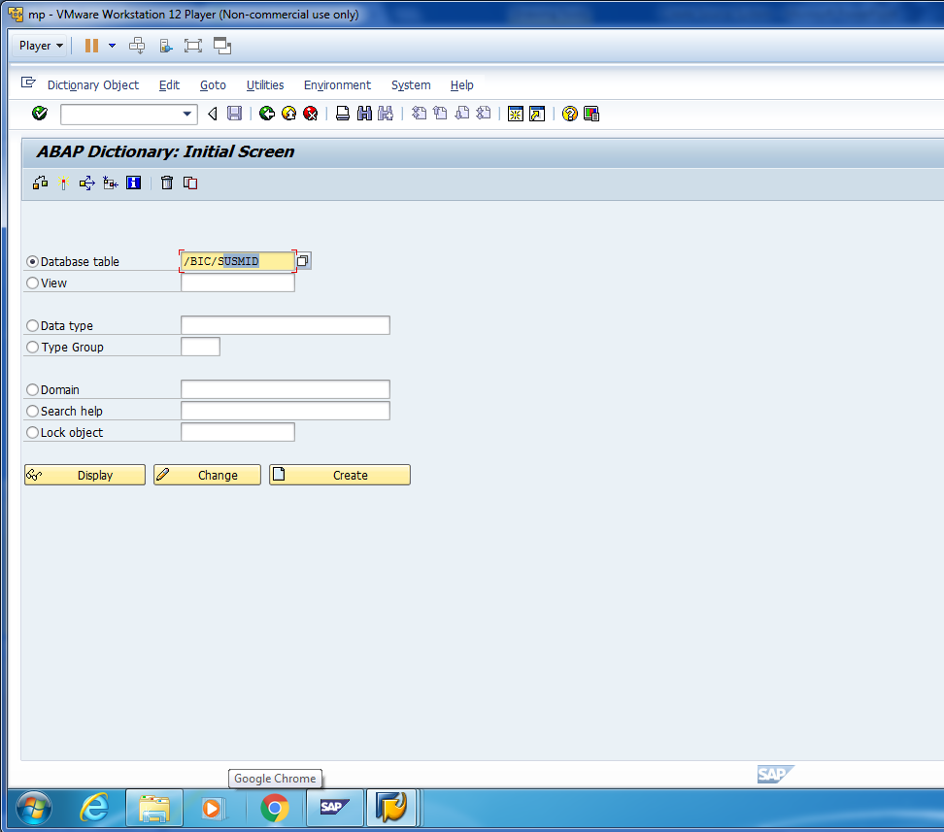
Similarly, we can check the data in S-Table.

Slide 27
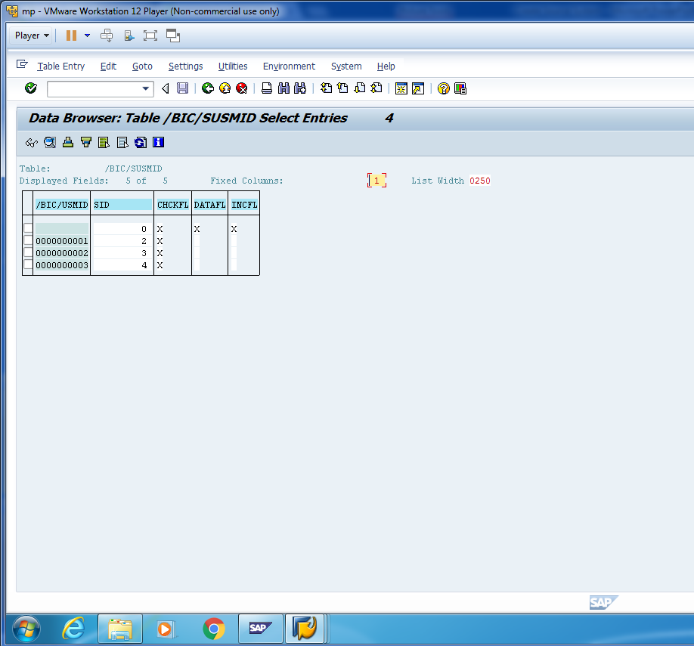
Content in S-Table.

Slide 28
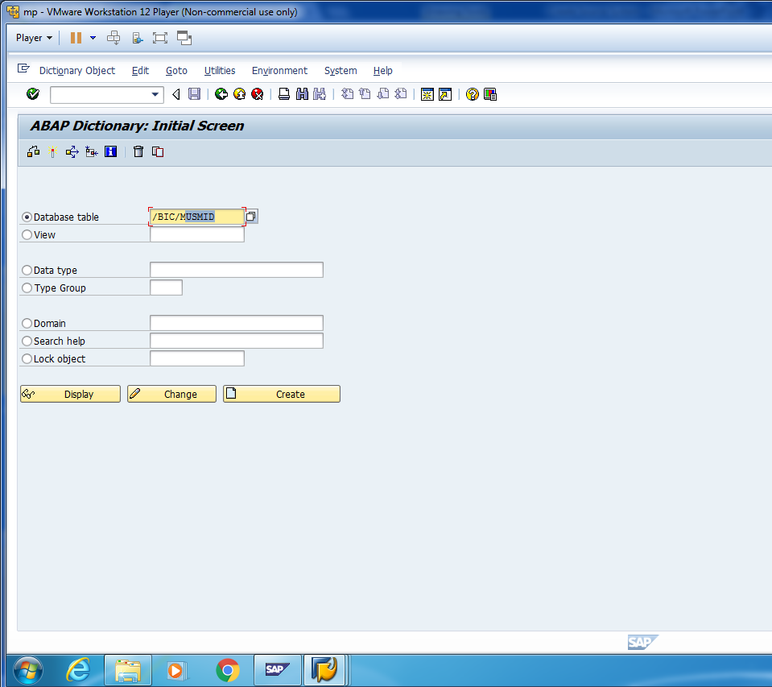
Similarly, we can check the data in M-View.

Slide 29
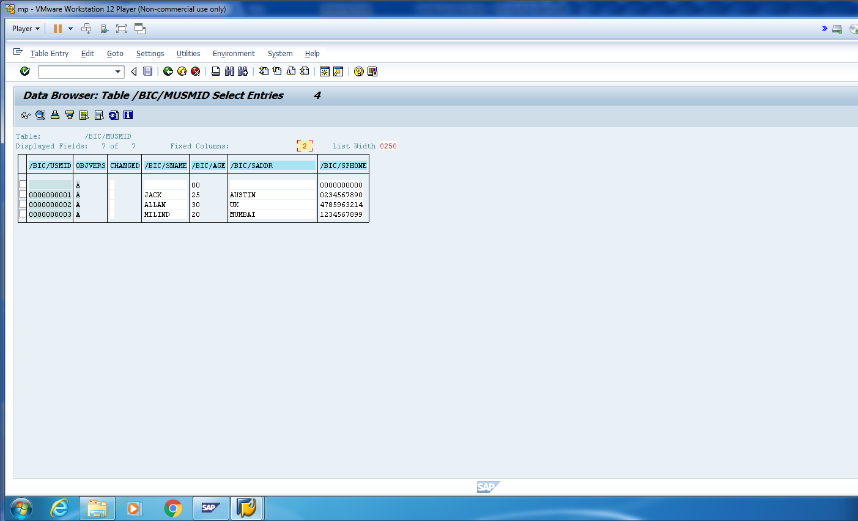
Content in M-View.

